Slide 1
Analysis of Hospital Readmission data: Conclusion
Group 5
Abhinay Sarvayyagari
Ashwin Venkatesh Prabhu
Febin Zachariah
Rujuta Mahindrakar

Slide 2
Quick Review
Main task : To predict if the patient will be readmitted or not
Additional Task 1 : predicting the number of days spent in hospital by the patient based on the data available at day 0 (first day of admission at the hospital)
Additional task 2 : predicting diagnoses 2 and 3 using the earlier diagnosis
Data cleaning and imputation

Slide 3
Continued….
Correlation analysis and Principal Component Analysis
Using correlation analysis, we recognized the variables which hold the highest significance for readmission
Regression Analysis – Created few models for the main task and predicted the accuracy (~55%)

Slide 4
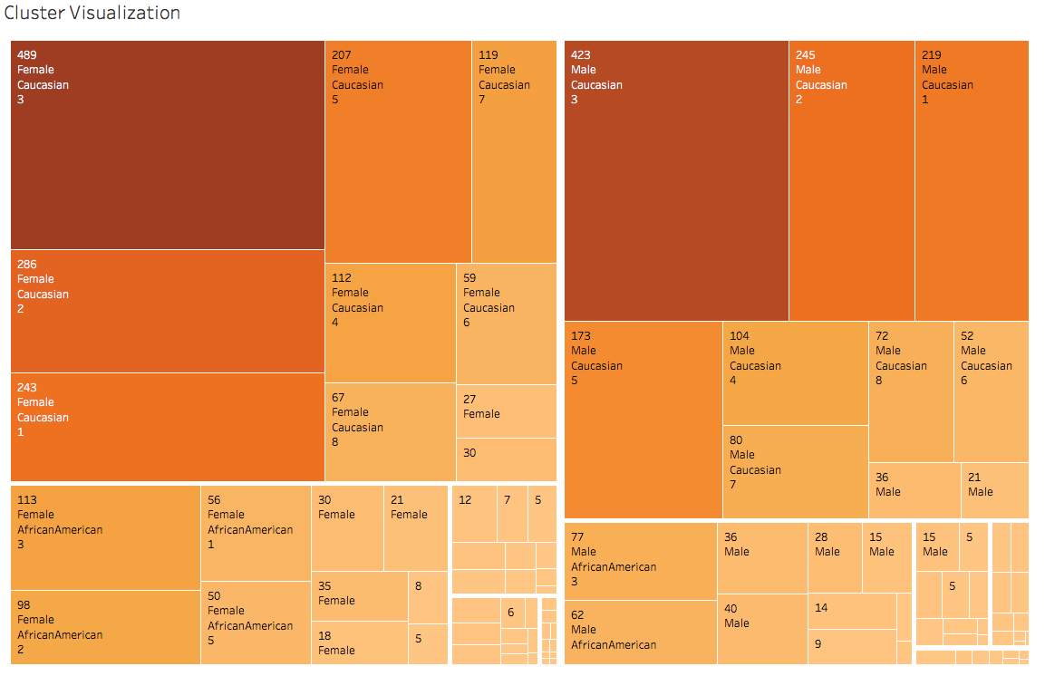
Cluster Visualization
Created clusters on features: diag_1, diag_2, diag_3, time_in_hospital, num_diagnoses,…

Slide 5
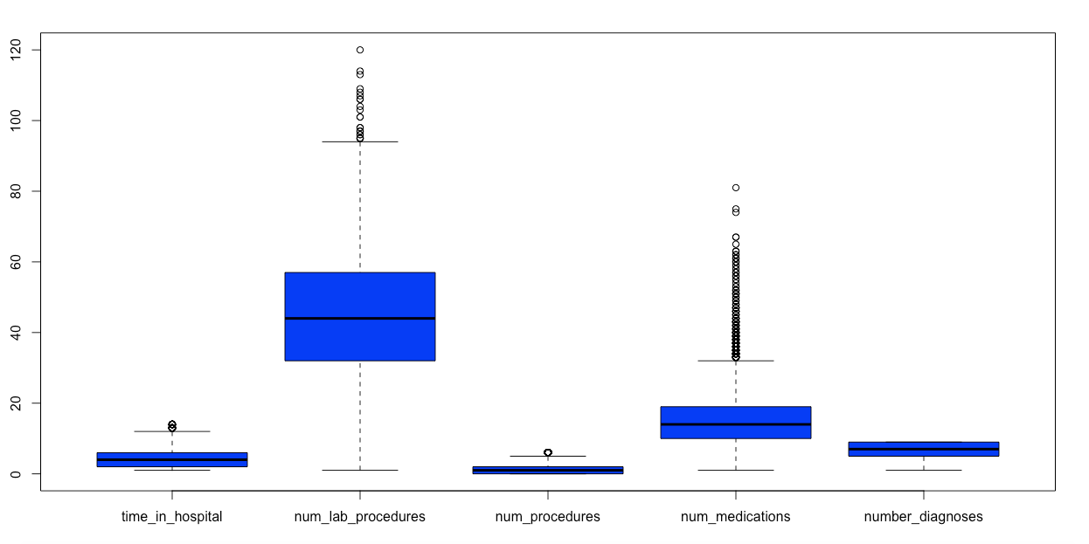
Outlier Detection
Notes:
Number of lab procedures = 120; Caucassian male, 40-50,time in hospital is 2, diagnosed with infectious and parasitic diseases, not readmitted
Number of lab procedures = 114; Caucassian male, 60-70,time in hospital is 14, diagnosed with diseases in respiratory system, not readmitted
Number of lab procedures = 113; Caucassian male, 20-30,time in hospital is 7, diagnosed with diseases in respiratory system and blood forming diseases, not readmitted
Nothing odd in num_medications

Slide 6
Pattern Mining
Ran Apriori algorithm to mine patterns on readmission rate
Readmission rate is higher for a male than for a female by a factor of 4
Readmission rate is low for a Caucasian female diagnosed with malignant neoplasms
Readmission is low among African Americans, who are diagnosed with either “endocrine, nutritional and metabolic diseases” OR symptoms, signs, and ill-defined conditions
For other races, readmission rate is very low when the patient consumes diabetes medicine

Slide 7
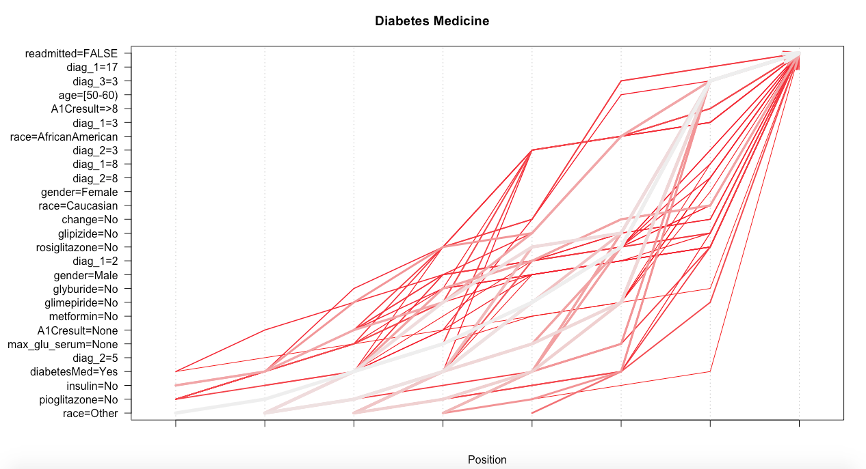
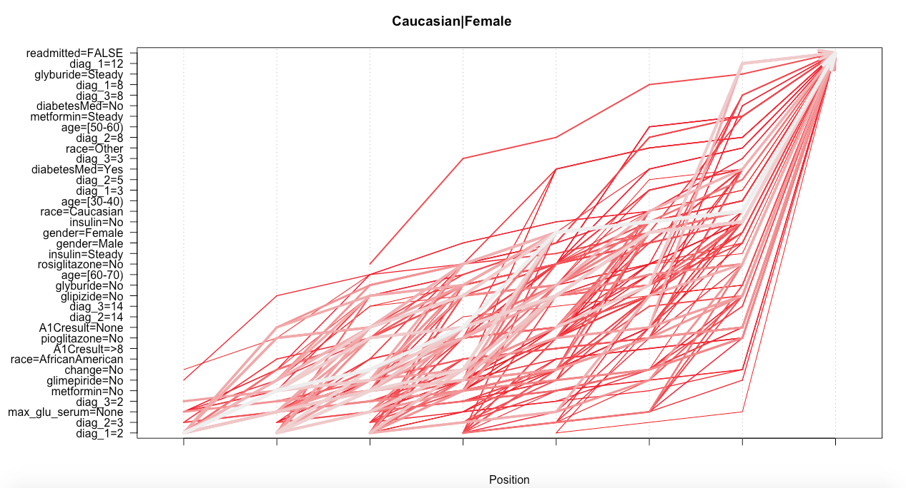
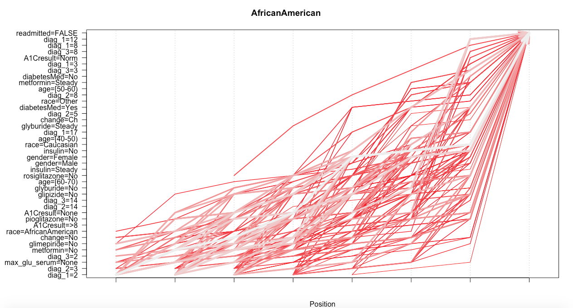
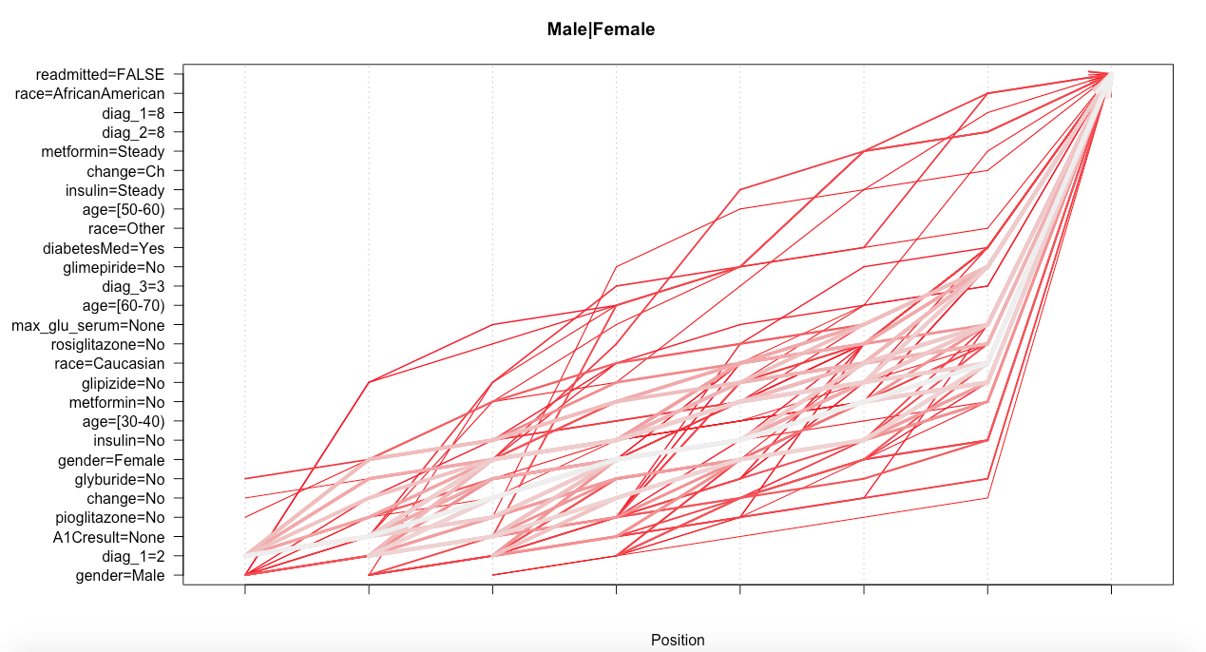

Slide 8
Feature Selection
Class Imbalance is a major problem in Machine Learning models
Occurs when one class dominates the other in categorical variables
The following classes were imbalanced, and deleted:
Repaglinide (”No”: 9870, “Steady”: 112, “Up”:13, “Down”:5)
Nateglinide (”No”: 9949, “Steady”: 49, “Up”:1, “Down”:1)
Chlorpropamide (”No”: 9987, “Steady”: 12, “Up”:1, “Down”:0)
Tolbutamide (”No”: 9997, “Steady”: 3, “Up”:0, “Down”:0)
Acarbose (”No”: 9968, “Steady”: 31, “Up”:1, “Down”:0)
Miglitol (”No”: 9995, “Steady”: 3, “Up”:1, “Down”:1)
Tolazamide (”No”: 9996, “Steady”: 4, “Up”:0, “Down”:0)
glyburide.metformin (”No”: 9944, “Steady”: 53, “Up”:2, “Down”:1)
glypizide.metformin (”No”: 9998, “Steady”: 2, “Up”:0, “Down”:0)
Acetohexamide, troglitazone, examide, citoglipton, glimperide.pioglitazone, metformin.rosiglitazone, metformin.pioglitazone have only 1 factor levels
Notes:
Rest of the features were retained!

Slide 9
Readmitted or Not?
Six classifier models were selected
Generalized logistic regression gave the best accuracy. But our personal best was SVM (because its instantaneous)
Classifier | ACCURACY | Running Time Rating (1-Fastest, 6-Slowest)
Support Vector Machines | 63.95 | 1
Generalized Logistic Regression | 64.6 | 3
Artificial Neural Networks | 63.35 | 6
Random Forest | 63.55 | 5
Naïve Bayes | 52.15 | 2
Decision Tree | 50 | 4

Slide 10
Task 1: Predicting the time spent in hospital
Time_in_hospital is a continuous variable
Diagnosis_2 and Diagnosis_3 are not considered for this task. (We assume that diagnosis_1 is done when the patient first visits the hospital, and at this point of time, diagnosis_2 and diagnosis_3 are not done. So we exclude them from this analysis)
Four models were created: Stepwise linear regression, Artificial Neural Network, Decision Tree, Random Forest Regressor

Slide 11

Modelling
Root Mean Square Error (RMSE) and Root Mean Square logarithmic Error (RMSLE) were the evaluation metrics
Stepwise Linear Regression performed the best
RMSLE =

Slide 12
Results
Regression model | RMSE | RMSLE | Running Time Rating (1-Fastest, 4-Slowest)
Step-Wise Linear Regression | 2.19 | 0.44 | 3
Artificial Neural Network | 4.06 | 0.96 | 4
Decision Tree | 2.28 | 0.45 | 1
Random Forest Regressor | 2.56 | 0.51 | 2
Neural Networks typically require more data points to train well…

Slide 13
Task 2: Predicting future diagnoses
Two sub problems: 1. Predicting diag_2, given diag_1 and the other attributes 2. Predicting diag_3, given diag_1, diag_2 and the other attributes
This is a multi-label classification problem!

Slide 14
Modelling
SVM, GBM, Random Forest and Artificial Neural Network were performed
SVM classified all labels into only the major classes: level 3 (Metabolic diseases) and level 8 (Metabolic diseases)
Random Forest was most efficient in classifying, still preferred the major classes
Gradient boosting gave roughly equal amounts to all classes
Neural Network’s performance was in between

Slide 15
Results
Classifier | Diag_2 (Accuracy) | Diag_3 (Accuracy) | Running Time Rating (1-Fastest, 4-Slowest)
Support Vector Machine | 38.67 | 39.44 | 1
Gradient Boosted Machine | 4.66 | 4.07 | 3
Random Forest Classifier | 40.68 | 38.15 | 2
Artificial Neural Network | 39.19 | 37.43 | 4
Random Forest was selected due to good accuracy and because it predicted all the classes, and wasn’t biased towards the major labels

Slide 16
Challenges
Accuracy for task 2 is not that great. We had to try out different classifiers in an attempt to improve the accuracy
Interpreting clustering plots
Majority classes were being over represented in predictions

Slide 17
Questions?

